Slide 1
Deep Learning 101

Slide 2

https://realpython.com/pytorch-vs-tensorflow/

Slide 3
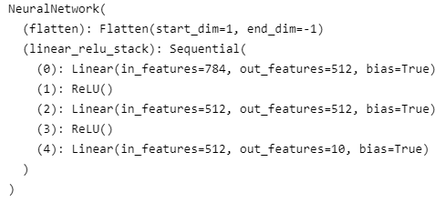
PyTorch Creating Models
class NeuralNetwork(nn.Module):
def __init__(self):
super(NeuralNetwork, self).__init__()
self.flatten = nn.Flatten()
self.linear_relu_stack = nn.Sequential(
nn.Linear(28*28, 512),
nn.ReLU(),
nn.Linear(512, 512),
nn.ReLU(),
nn.Linear(512, 10)
)
def forward(self, x):
x = self.flatten(x)
logits = self.linear_relu_stack(x)
return logits
model = NeuralNetwork(); print(model)
Notes:
https://pytorch.org/tutorials/beginner/basics/quickstart_tutorial.html

Slide 4
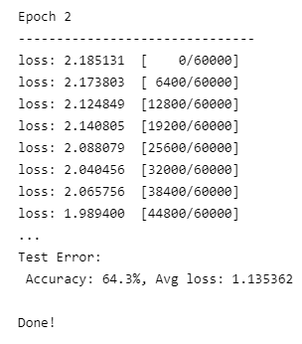
PyTorch Train/Test
epochs = 5
for t in range(epochs):
print(f"Epoch {t+1}\n--------------------------")
train(train_dataloader, model, loss_fn,optimizer)
test(test_dataloader, model, loss_fn)
print("Done!")
Notes:
https://pytorch.org/tutorials/beginner/basics/quickstart_tutorial.html

Slide 5

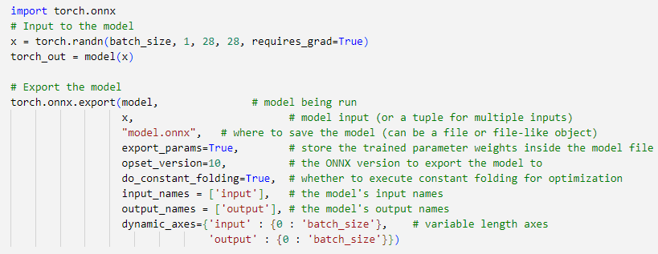
PyTorch ONNX Export
import torch.onnx
# Input to the model
x = torch.randn(batch_size, 1, 28, 28, requires_grad=True)
torch_out = model(x)
# Export the model
torch.onnx.export(model, # model being run
x, # model input (or a tuple for multiple inputs)
"model.onnx", # where to save the model (can be a file or file-like object)
export_params=True, # store the trained parameter weights inside the model file
opset_version=10, # the ONNX version to export the model to
do_constant_folding=True, # whether to execute constant folding for optimization
input_names = ['input'], # the model's input names
output_names = ['output'], # the model's output names
dynamic_axes={'input' : {0 : 'batch_size'}, # variable length axes
'output' : {0 : 'batch_size'}})
Notes:
https://pytorch.org/tutorials/advanced/super_resolution_with_onnxruntime.html

